Slide 1
Greener London:
London's Progress Towards an Environmentally Sustainable City
during 2012 Olympics
Group 5
Hong YANG
Yimin FU
Zheng LIANG

Slide 2
Contents
01
Background
02
Project Aims
03
Project Design & Technical Decisions
04
Limitations & Future Improvements

Slide 3
1. Background
Sustainable development: a common challenge for modern cities
Environmental, social and economical
Create a London that is resilient to global issues like climate change or resource scarcity, and secures quality of life now and for its future citizens (London Sustainable Development Commission, 2013)

Slide 4
1. Background
The London 2012 team also considered sustainability as one of the key elements during the Games and after (as an Olympic legacy), listing improvements in carbon emissions, energy and waste recycling as main objectives (London Assembly Environment Committee, 2008).
‘make the Olympic Park a blueprint for sustainable living’
——Department for Culture Media and Sport, 2008
Sustainability policies:
The UK Low Carbon Transition Plan 2009
London zero-waste target
London 2012 Sustainability Policy
…

Slide 5
2. Project Aims
How do we know if London is making progress towards becoming a sustainable city?
Clear visualization
Temporal and spatial comparisons
Interactivity

Slide 6
3. Project Design & Technical Decisions
Based on the background research in previous sections and further literature review (London Sustainable Development Commission, 2009, 2013), we select Air Pollutant Emissions, Energy Consumption and Waste Recycling in London as essential dimensions of our project.

Slide 7
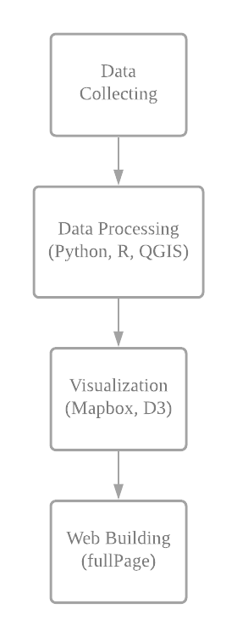
3.1 Work Flow and Tools used

Slide 8
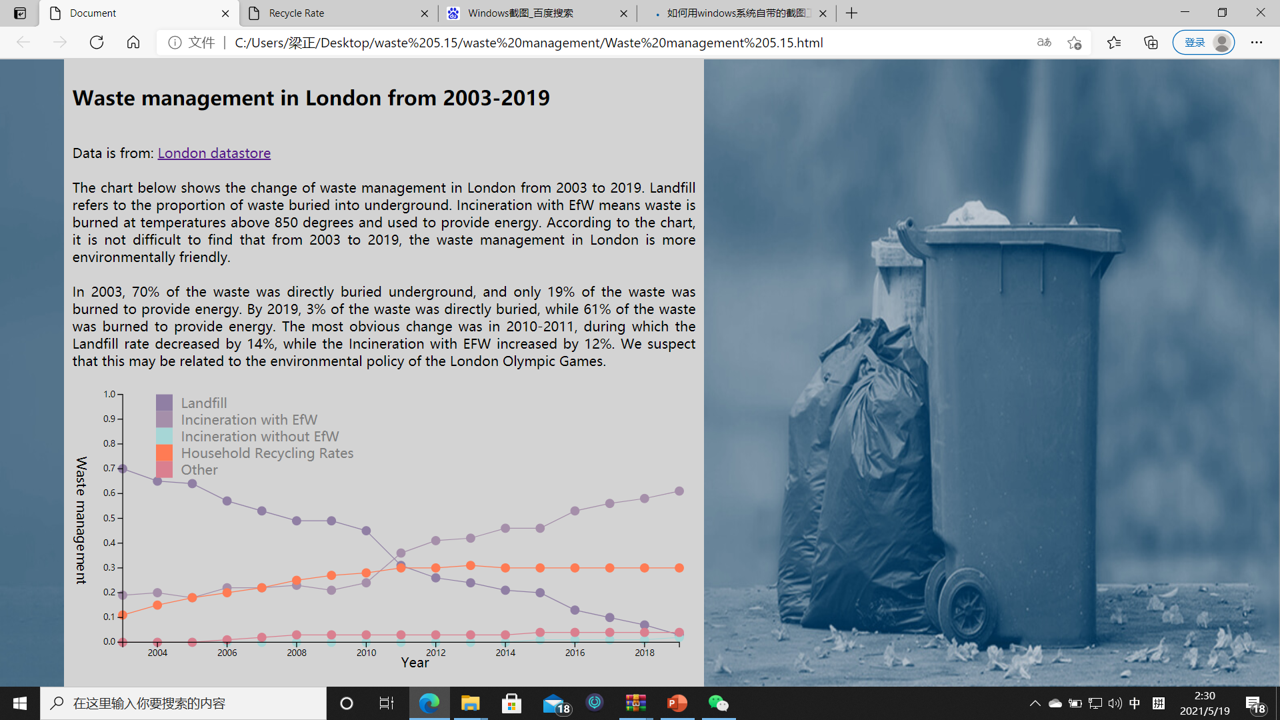
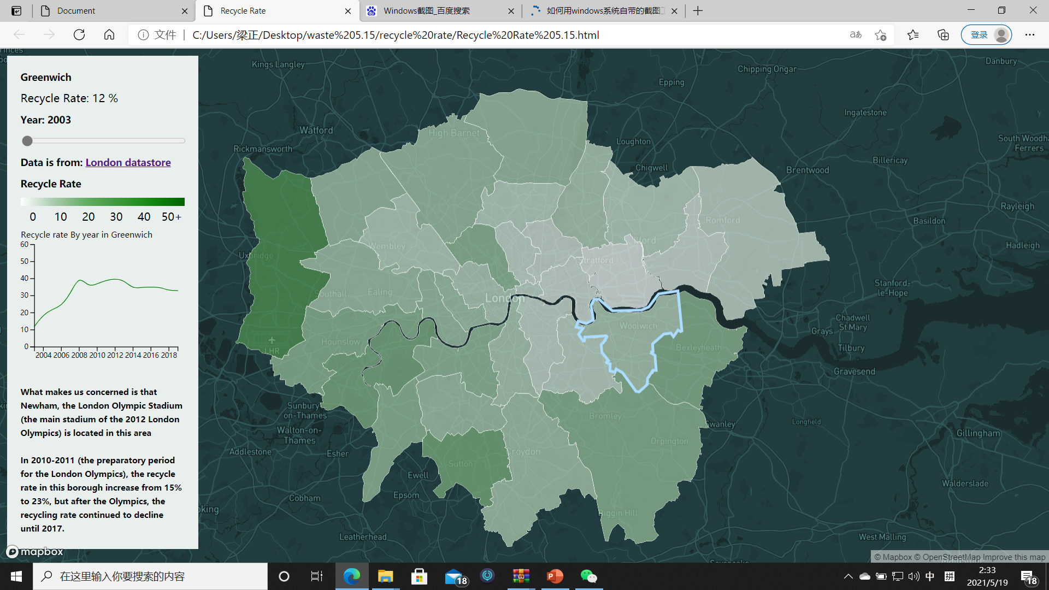
3.2 Visualization Design
Waste management
2003-2019
City level
Local Authority Collected Waste Management (London Data Store)
Percentage of different method
interactive line chart
Borough level
Household Waste Recycling Rates (London Data Store)
Recycle Rate
interactive line chart and interactive choropleth map

Slide 9
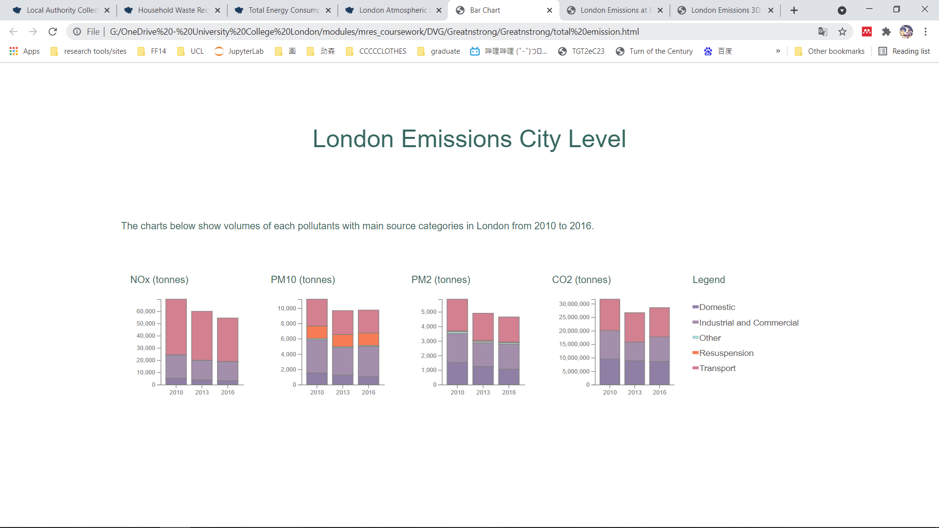
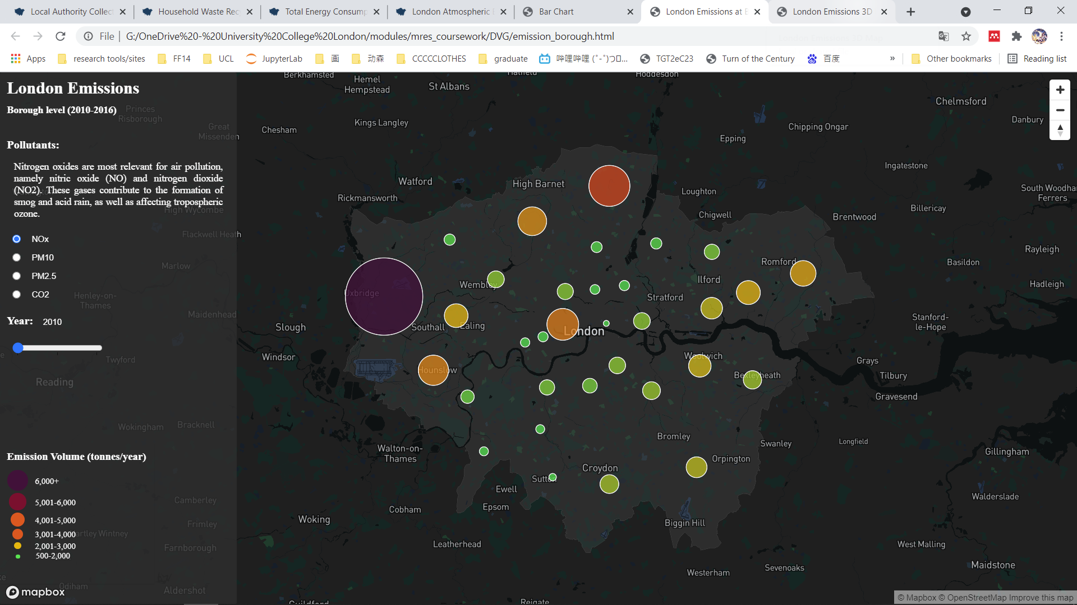
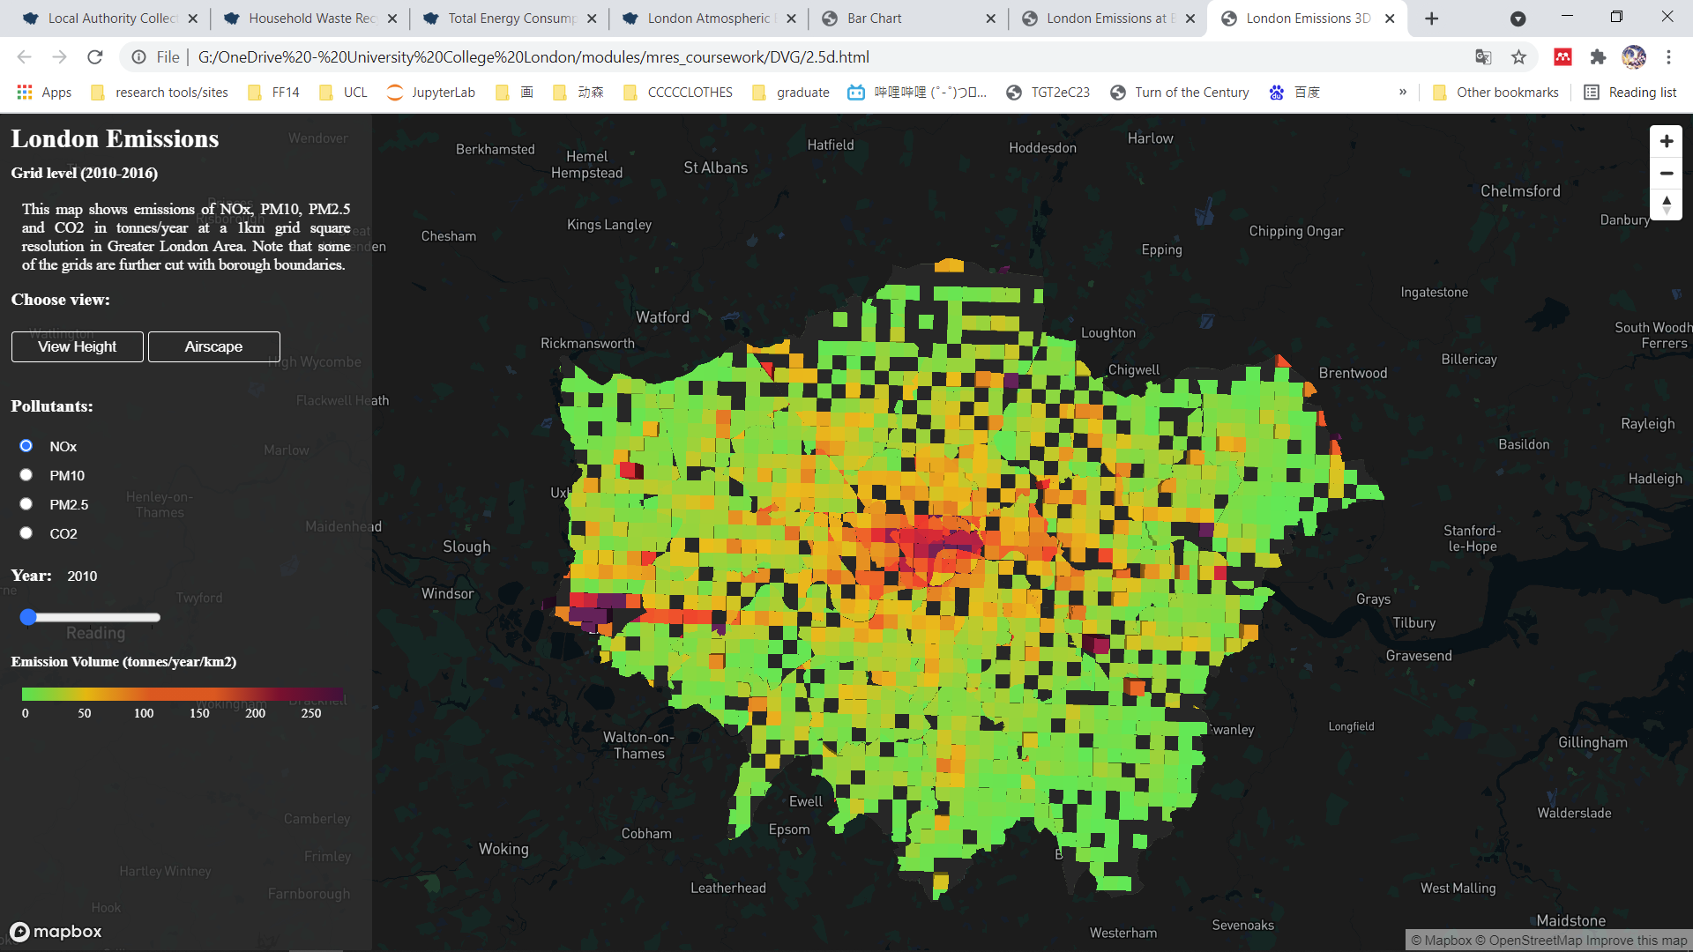
3.2 Visualization Design
Air Pollutants Emission
London Atmospheric Emissions (London Data Store)
2010-2016
Major pollutants: CO2,Nox, PM10,PM2.5
Tonnes/year
City level
interactive bar plot
Borough level
Interactive map
Proportional circle
Switch between time period and pollutants
Independent legends
Grid level
Interactive map
2.5d
Switch the angle of viewing

Slide 10
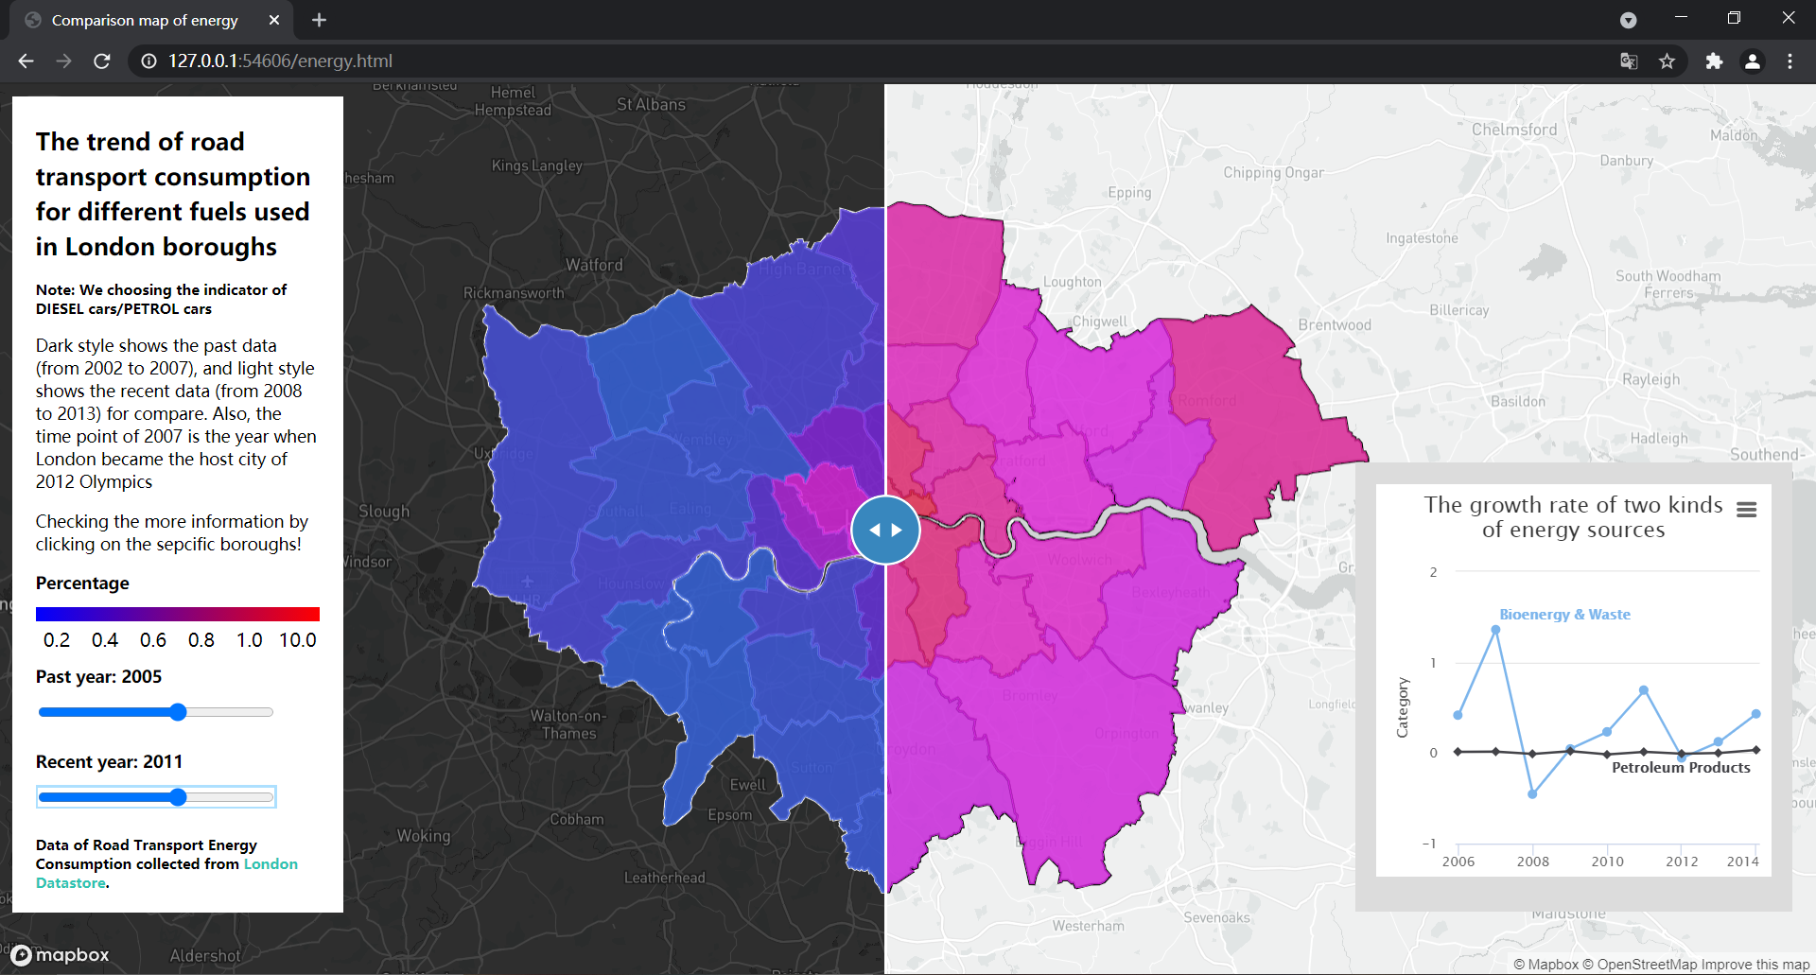
3.2 Visualization Design
Energy
City level
Total Energy Consumption(London Data Store)
2005-2014
Line chart
Borough level
Road Transport Energy Consumption (London Data Store)
2002-2013
Interactive maps
Comparison is achieved by swiping between a ‘map of past’ and ‘map of recent’.

Slide 11
3.3 Website Design
Scrolling
Navigation panel
Coherent storytelling
Overall delivery

Slide 12
4. Limitation and Future Improvement
It is important to note that although the 2012 Olympics was a strong driving force for sustainable development during the period, it is not the only reason for the changes presented in our project
Completing website
Adjust the style of each part
Time period of energy part
Comparison between different pollutants cannot be sensed in Emission map – add line chart

Slide 13
Data Sources
https://data.london.gov.uk/dataset/total-energy-consumption-borough
https://data.london.gov.uk/dataset/road-transport-energy-consumption-borough
https://data.london.gov.uk/dataset/london-atmospheric-emissions-inventory--laei
https://data.london.gov.uk/dataset/local-authority-collected-waste-management-london
https://data.london.gov.uk/dataset/household-waste-recycling-rates-borough

Slide 14
References
Department for Culture Media and Sport (2008) Our promise for 2012: How the UK will benefit from the Olympic Games and Paralympic Games. Available at: www.uksport.gov.uk (Accessed: 17 May 2021).
London Assembly Environment Committee (2009) The Environmental Sustainability of the London 2012 Olympic and Paralympic Games.
London Sustainable Development Commission (2009) London’s Quality of Life Indicators: 2008-2009 Report.
London Sustainable Development Commission (2013) London’s Quality of Life Indicators: 2012 Report. Available at: www.londonsdc.org.uk (Accessed: 18 May 2021).
United Nations World Commission on the Environment (1987) Our Common Future. Available at: http://www.un-documents.net/wced-ocf.htm (Accessed: 18 May 2021).

Slide 15
Thank you

